Slide 1
Actionscript 3.0 Basics
5 – Assets Management

Slide 2
Flash Resource Management
Embedded in the application file.
vs
Load from external location.

Slide 3
Embedding
[Embed] Metadata Tag
Is a compiler directive that allows you to inject file data inbetween the as3 bytecode.
(only for flex compiler)

Slide 4
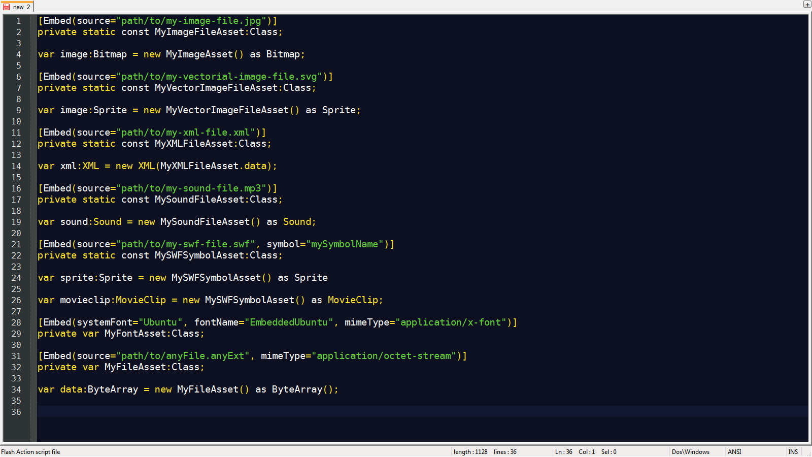
Embedding Images

Slide 5
Embedding XML
Bug: Embedded XML files can't have document type declarations.
<?xml version=”1.0”?>

Slide 6
Embedding Anything

Slide 7
Pros & Cons
Easy and straightforward
Many formats supported
Simpler Code
No waiting for the assets to load
Increases the application size
Exponentially increases the initialization time of the application.

Slide 8
Loading from external location.
Loaders
For General Purpose:
UrlLoader
For Images and Swfs:
Loader
For sounds:
Sound
For Video
Video and NetStream

Slide 9
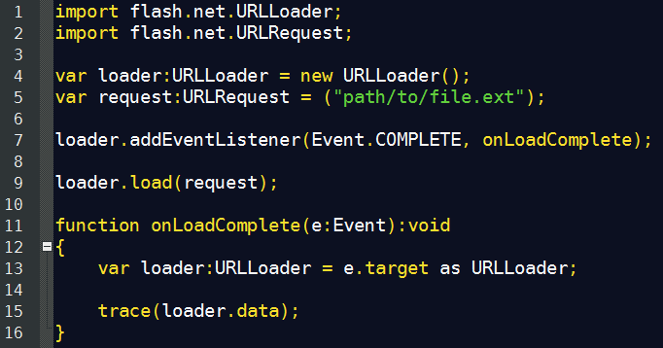
URLLoader

Slide 10
Pros & Cons
Application size reduces.
While the assets load the user can still interact with the app.
No need to recompile if assets change.
Different apis for different kinds of assets.
Complex(ish) code.
Asset loading is restricted by security polices
(no cross-domain requests for some file-types)

Slide 11
Working with XML
XML & XMLList
E4X Syntax

Slide 12
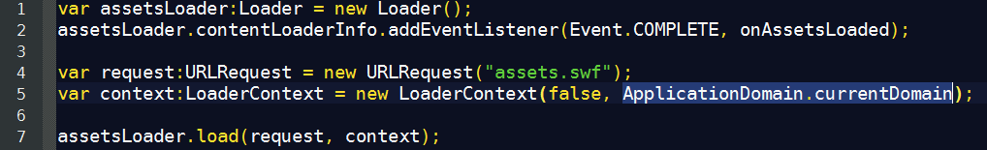
Assets Libraries

Slide 13
Working with Sound
Sound
SoundChannel

Slide 14
Thanks!
github.com/matix/as3basics
matias.figueroa@globant.com
@matixfigueroa

